Slide 1
Efficiency and Bus Fleet Management: Strategic Communications and quantifying GHG and other co-benefits (#BBUS)
Sustainable Mobility Team
02 July 2026
© Council on Energy, Environment and Water, 2026

Slide 2

Impacting sustainable development at scale with data, integrated analysis, and strategic outreach
TRANSFORMATIONS
QUALITY OF LIFE
ENABLERS
390+
Multidisciplinary team
550+
Peer-reviewed publications
700+
Convenings
400 million+
Lives impacted
11
Union ministries supported
20+
State governments supported
Low-carbon Economy
Clean Air
Sustainable Finance
Energy Transitions
Sustainable Water
Technology Futures
Power Markets
Sustainable Food Systems
Circular Economy
Industrial Sustainability
Sustainable Cooling
Climate Resilience
Sustainable Livelihoods
Sustainable Mobility
International Cooperation
SPECIAL INITIATIVES
CEEW Green Finance Centre
Powering Livelihoods
Emerging Economies
UP State Office

Slide 3
The project’s key components
M1 - Socio-economic co-benefits, especially for women, low-income groups, & vulnerable road users
M2 - Health and air quality benefits from increased bus usage and reduced reliance on private vehicles
4-in-1 co-benefits model of bus-based public transport
M3 - Greenhouse gas (GHG) mitigation potential benefits
of bus deployment
M4 - Resilience & adaptive benefits of robust bus transport on the economy and physical infrastructure
Easing access to climate, green funds and other potential avenues for bus and allied infrastructures
Build institutional support for bus systems through strategic communication
Source: CEEW compilation

Slide 4
Deep dive in M1 : Socio Economic co-benefit model
Literature Review — Geographic Coverage & Key Sources (n = 27)
Similar economic regions to India (Global South, developing/emerging cities).
Very limited direct Indian literature , make the case stronger for the project
Geographic Coverage
Economic & Social Impacts Scoping Review (Global)
South and South-East Asia
Methodology evolution from CBA to resilience & social inclusion; 30+ publications synthesised globally
Bogotá, Lagos, Dhaka, Lahore, Santiago
33%
Chicago Transit Impact Study — Agent-Based Model (2024)
Global South (59%)
East Asia (China, South Korea)
BCR = 13:1; transit removal costs $35.4B; 53.7% of non-work losses fall on women
Shenyang, Hangzhou, Beijing — comparable urban scale
18%
India
Rome Metro DID — Economic Activity (2024)
Delhi NMT co-benefit study , Surat
Quasi-experimental: new metro line increases economic establishments within 1km of stations
8%
Delhi NMT Co-benefit Study (2022)
Australia / New Zealand
Only India study found; VSL-based method yields USD 4,870M/yr & 121.5 kt CO₂ reduction from NMT shift
Melbourne — advanced PT equity & health studies
Global North (41%)
15%
North America / Europe
Bogotá BRT Socioeconomic Study (COVID-19)
Toronto, Rome, Chicago, Miami, Austria, Atlanta
Lower-income strata cannot reduce PT trips in crisis — demonstrates critical transport dependency
26%
Key Research Gap: Limited Indian study found (Delhi NMT/active transport). Socio-economic evidence base is largely from similar economic-context cities — transferability assumed but needs validation.
4|
Source: CEEW compilation

Slide 5



Deep dive in M1 : Socio Economic co-benefit model
Detailed analysis of Model and parameters
Structural Equation
Model (SEM)
Difference-in-
Differences (DID)
Multivariate
Regression
Spatial / GIS
Analysis
Key Parameters
Key Parameters
Key Parameters
Key Parameters
Service quality (safety, comfort, freq.)
Before vs. after bus deployment
Employment & livelihood indicators
Bus stop catchment & accessibility buffers
Perceived accessibility & inclusion
Group A vs. Group B cities
Affordability & income metrics
Hotspot analysis (Getis-Ord)
Quality of life & wellbeing
Control vs. treatment zones
Health & resilience outcomes
O-D mapping low-income commuters
Policy support & latent constructs
Measurable impact attribution
City productivity proxies
Accident & safe travel zone mapping
Captures abstract outcomes like social inclusion, transport justice & perception changes
BBUS project structure (Group A/B) is naturally suited to DID — measures causal impact
Identifies which variables are most impacted by bus service; separates bus effect from correlated factors
Maps existing network gaps, underserved areas, and validates BBUS route equity coverage
5|
Source: CEEW compilation

Slide 6
Deep dive in M1 : Socio Economic co-benefit model
Groupwise Model Selection
Group A - Cities with buses
Group B - Buses incoming
Bengaluru | Jaipur | Bhubaneswar
Jodhpur | Gandhinagar | Puducherry
Multivariate Regression
Why?
Group A cities have mature bus system. Buses have been in operation for years. No clean pre and post study is feasible.
Cross-sectional association via multivariate regression — estimates the relationship between proximity to bus routes and outcomes, controlling for household and neighbourhood characteristics including the Vulnerability Index
Difference in Difference(DiD)
Why?
Deployment of Buses under the scheme serves as a natural experiment for DiD to estimate the causal effect of bus access on socio-economic indicators.
Credible counterfactual via parallel trends — households near routes not yet activated serve as the comparison group, isolating the effect of new bus deployment from pre-existing differences across neighbourhoods
Descriptive analysis (cross-tabs, means, distributions) where regression is infeasible.
GIS-derived bus access (500m walkshed, binary) as the key independent variable — exogenous to individual behaviour.
6|
Source: CEEW compilation

Slide 7
Key Variables
Outcome Variables
Independent Variable
Vulnerability index(VI)
hf
Individual Transport Expenditure
Employment Status
Female Employment Status
Women's trip frequency
Value of travel time saved
Educational Access for children/youth
Health care access
Bus Access
(VI) is constructed as an unweighted normalised composite of four binary components that capture dimensions of socio-economic vulnerability.
The VI is used to test whether the economic benefits of bus access are disproportionately larger for more vulnerable populations.
Walking distance to nearest bus stop (minutes/metres) — collected via survey and cross-validated using GIS data from STU route maps.
This approach was chosen for its simplicity and alignment with internationally recognised thresholds.
Women's trip frequency — regression restricted to women in households without private vehicle access (captive users), controlling for income, to isolate the bus access effect from private vehicle availability bias.
7|
Source: CEEW compilation

Slide 8
Vulnerability Index : Construction
Index Components
Income
VI = (Income + Vehicle_ownership + Disability status + Elderly) / 4
Min-max normalised, reversed: 1 = lowest income
Range: 0 (least vulnerable) → 1 (most vulnerable)
Vehicle Ownership
No vehicle in household = 1; owns vehicle = 0
Rationale for the unweighted index
Equal importance to all dimensions.
The most credible and widely used composite indices in development policy use equal weights.
Disability Status
Person with disability = 1; no disability = 0
Elderly
Note on Gender
Age 60 or above = 1; below 60 = 0
Gender excluded from index — used as a stratification variable to avoid treating all women as uniformly vulnerable regardless of income or vehicle access.
8|
Source: CEEW compilation

Slide 9
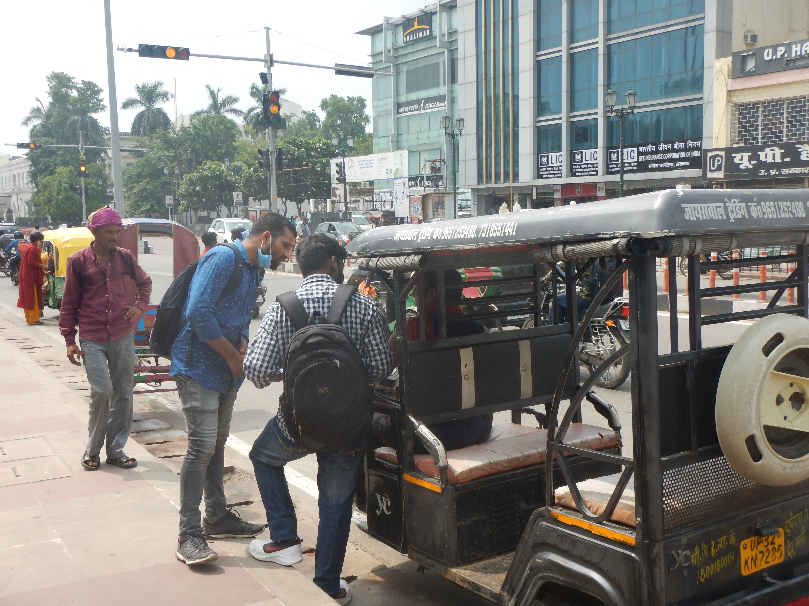
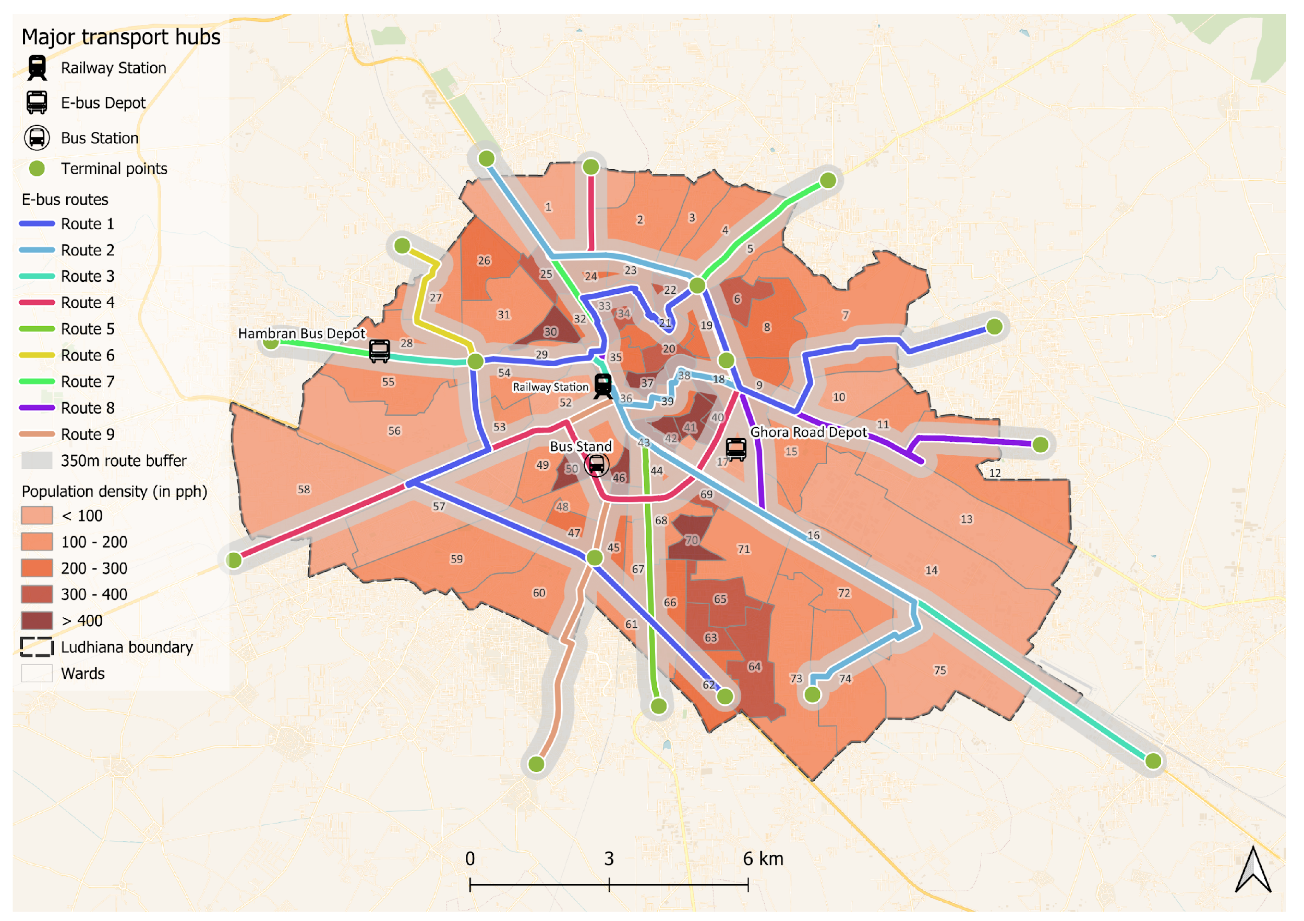
Group A cities: Design and framework
Yij = β₀ + β₁(bus_access_{ij}) + β₂(VI_{ij}) + β₃(bus_access_{ij} × VI_{ij}) + β₄X_{ij} + β₅ Γ_{j}+εij
β₁ (bus_access)
β₂ (VI)
β₃ (bus_access × VI)
KEY TREATMENT EFFECT
VULNERABILITY MAIN EFFECT
EQUITY COEFFICIENT
Average difference in outcome between individuals with bus access (≤500m) vs. without, for the reference group (VI = 0). Core policy number.
Effect of being more vulnerable on the outcome, independent of bus access. Captures baseline disadvantage of VRUs.
Differential benefit of bus access for more vulnerable individuals. Significant positive β₃ is the core equity argument for bus investment.
A survey gives you the individual characteristics
The route network gives you the spatial coverage characteristics
9|
Source: CEEW compilation

Slide 10
Group B cities study design and framework
Yijt = β₀ + β₁(bus_access_{ij}) + β₂(bus_access_{ij} × post_{t}) + β₃(bus_access_{ij} × VI_{ij} × post_{t}) + β₄(VI_{ij}) + β₅X_{ijt} + β₆Γ_{j}+ λ_{t}+εijt
2×2 Difference-in-Differences Structure
Round 1 (Pre)
Round 2 (Post)
Thus, it becomes very important to align with the PM e-Bus Sewa deployment schedule and collaborate with the Ministry of Housing and Urban Affairs from the early stages of the project
Treatment Zone
(Bus Access)
Baseline (A)
Endline (B)
Control Zone
(No Bus Access)
Baseline (C)
Endline (D)
DiD Estimator = (B − A) − (D − C)
The parallel trends assumption is the core identifying assumption in difference-in-differences (DiD) estimation
Since only one pre-deployment wave is collected, the parallel trends assumption cannot be tested statistically. Will be acknowledged as a limitation
Treatment: within 500m GIS walkshed of planned bus stop/route
Control: beyond 500m, matched on baseline income, density & infrastructure
10|
Source: CEEW compilation

Slide 11
Deep dive in M3 : GHG emission and Mitigation co-benefit model
Literature Review — Geographic Coverage & Key Sources (n = 12)
ASIF Framework
On going Research
Literature Review still focused on India and similar economic region
Activity × Structure × Intensity × Fuel
Passenger-km by mode
Modal share (%)
Energy per pax-km
Geographic Coverage
Emission factor (kgCO₂/MJ)
BBUS: Core architecture for BBUS GHG model — used by TERI, IEA, ITF & ICCT
India
7 studies — national, city-level & multi-city
58%
Modal Shift Savings
Displacement / Substitution Approach
Global / OECD Frameworks
India EF: 2W = 0.051 kgCO₂/km
2 studies — ITF-OECD, UNFCCC-aligned
Bus = 0.015 kgCO₂/pax-km
17%
Saving: 0.036 kgCO₂/pax-km (2W→Bus)
West Africa (Burkina Faso)
Travel diary data for actual shift
1 study — developing country analogy
BBUS: Core BBUS impact calc — requires before/after survey of new bus users
8%
Global Meta-Analysis
ITF WTW / TTW
2 studies — cross-country model comparison
Well-to-Wheel & Tank-to-Wheel LCA
Scope 1/2/3 boundaries
17%
Load-factor adjusted EF
Grid carbon intensity
Vehicle lifetime GHG
BBUS: Aligns BBUS with UNFCCC/NDC reporting; both TTW & WTW should be reported
11|
Source: CEEW compilation

Slide 12
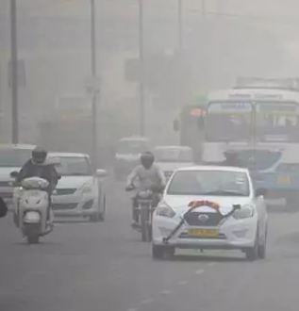


Deep dive on existing available GHG calculation tools online
Tool | Remarks
IFI TWG Harmonised Tool (UNFCCC) | For BBUS, the "no-bus" baseline would have to be hand-built route-by-route across the whole city, which is labour-intensive and prone to inconsistent assumptions across routes.
ITF-OECD India LCA Tool (ITF/NDC-TIA, India specific) | it can't capture mode-shift or latent demand if the bus service were withdrawn, so it can't size the emissions a city avoids by having buses at all.
Green House Gas Protocol – GHG Calculation Tool (WRI/WBCSD corporate & city tools) | it doesn't natively include upstream WTT chains or embodied battery-manufacturing carbon. No PM calculation
UNFCCC GHG CRT Tool (UNFCCC) | there is no methodology for 2W/informal-transit substitution, No modal shift scenario the mode-shift BBUS needs to quantify if buses were absent.
India GHG Program Tool (WRI India/TERI/CII) | Cannot model a bus-absent scenario, so it can't support a city-wide with-bus vs. without-bus GHG comparison, which is the core BBUS question.
12|
Source: CEEW compilation

Slide 13


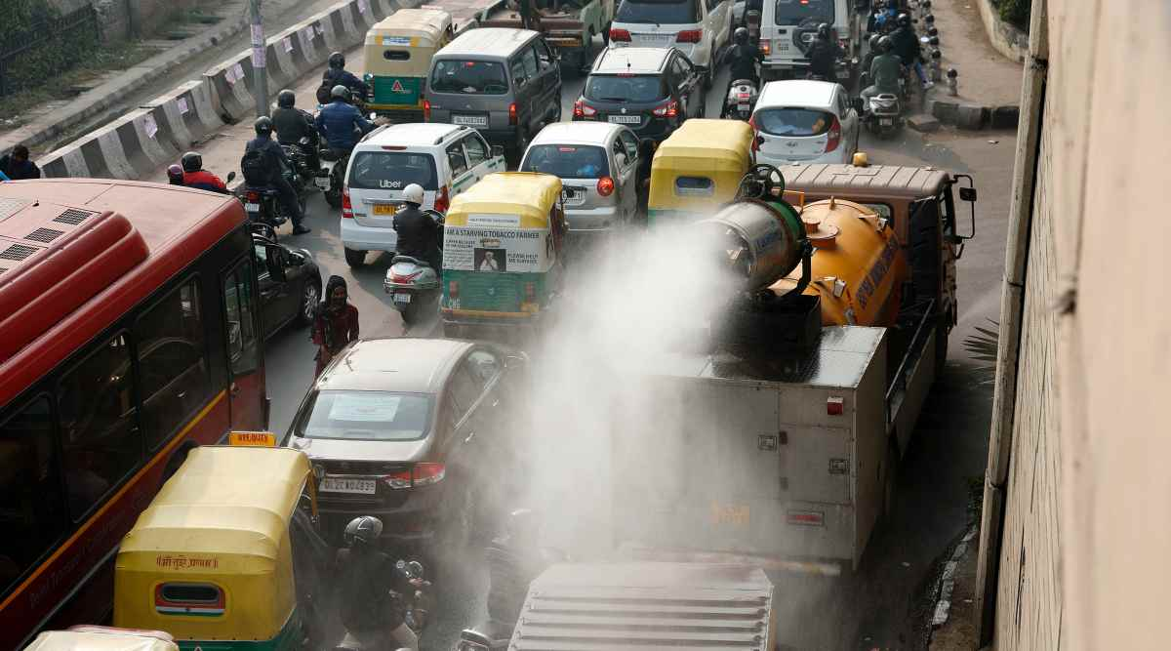
Final model framework and parameters for M3- GHG emission and mitigation
Group A cities with existing bus services / Other Modes
(Activity X Structure X Intensity X Fuel)- ASIF framework { Tailpipe } + GREET model {Non-Tailpipe}
ET Framework (Greenhouse gases, Regulated Emissions and Energy use in Technologies)
1. Activity (Transport Activity Level )-
Vehicle KilometersTraveled (VKT)
Vehicle Occupancy / Load factor
Vehicle Utilisation rate
Fleet number
Average trip length
Tailpipe Emissions
Non- Tailpipe Emissions
Non- Tailpipe Emissions
Grid Emissions
Battery Manufacturing
ICE bus
E bus
2. Structure- Technology/ Fuel - (All variables are equally critical)
Modal Share
Vehicle category distribution
Fuel mix (Petrol/ diesel/CNG/electric)
Technology mix (ICE/HEV/PHEV/BEV/FCEV)
Fleet age distribution
Pollutants to be calculated
Base Framework
GHG emission
PM 2.5
3. Intensity (Energy/ Fuel)
Energy consumption
Fuel consumption
PM 10
4. Fuel Factor (Carbon content)
For different Fuel
NOx
13|
Source: CEEW compilation

Slide 14
Final model framework and parameters for M3- GHG emission and mitigation
Group B cities with no bus services -
Modal shift savings + ASIF Framework + GREET model (similar to Group A cities)
Scenario development (will be changed according to context)
Scenario | 2W shift | IPT shift | 4W shift | Coverage | Type of bus procurement
Low ambition | 5% | 5% | - | 30% | 100% ICE fleet
Moderate ambition | 15% | 15% | 5% | 60% | 50% ICE + 50% EV
High ambition | 25% | 20% | 15% | 80% | 100% EV fleet
Each scenario will give -
GHG (t) =GHG(TTW​)+GHG (WTT)​+GHG (Grid) +GHG (B)
Mitigation on each scenario will be calculated-
Baseline - Scenario
14|
Source: CEEW compilation

Slide 15
Deep dive in M2: Health Co-benefits Model Literature review — geographic coverage & key papers (n= 11 papers)
.
Geography | Papers/Reports | Count | Share
North America | Maizlish San Francisco, Besser USA, Saelens King County, Legrain Montréal, duplicate Saelens file | 5 | 45%
Europe / UK | Madrid, HIA Scotland Guide, On the Buses London, Coimbra | 4 | 36%
Asia / Middle East | Tehran low-emission transport system | 1 | 9%
Global / Review | Raza air-pollution HIA review | 1 | 9%
Key inference: Most available evidence comes from North America and Europe/UK. India-specific evidence on bus-related health co-benefits is limited, especially for small and medium cities.
BBUS contribution: BBUS will fill this gap by combining primary surveys, GIS-based exposure mapping, health indicators, and Indian city-level bus deployment data.
15|
Source: CEEW compilation

Slide 16
Deep dive in M2: Health Co-benefits Model Pathways of Health Benefits from Bus-Based Public Transport
Bus deployment / improved bus service
Increased bus access and bus usage
Reduced dependence on private vehicles
Health benefit pathways
Health benefit pathways
1. Active Travel Gains
Walking to and from bus stops increases daily physical activity.
2. Air Pollution Exposure Reduction
Mode shift from private vehicles to buses can reduce PM2.5/NO2 exposure and emissions.
3. Road Safety Benefits
Shift from two-wheelers/cars/shared modes to buses can reduce crash and injury exposure.
4. Commute Stress Reduction
Reliable, affordable, safe, and comfortable bus services can reduce daily commute stress.
16|
Source: CEEW compilation

Slide 17
Deep dive in M2: Health Co-benefits Model Models identified from literature
Integrated Transport and Health Impacts Model (ITHIM) Links travel behaviour, physical activity, PM2.5 exposure, road injuries, and DALYs.
Health Impact Assessment (HIA) Structures, health pathways, affected population groups, and monitoring indicators.
Comparative Risk Assessment (CRA) Converts exposure changes into health burden using relative-risk functions.
Difference-in-Differences (DiD) / Natural Experiment Estimates the pre-post impact of new bus deployment in Group B cities.
GLM / Multivariate Regression Estimates health outcomes while controlling for income, gender, education, and city differences.
Ordered Logit / Ordered Probit Models commute stress and perception-based outcomes measured on 1–5 scales.
GIS / Spatial Exposure Analysis Maps bus access, walking distance, PM2.5 exposure, and crash-risk exposure.
A-S-I Co-benefits Framework Links Avoid–Shift–Improve actions with emissions reduction and public health benefits.
17|
Source: CEEW compilation

Slide 18
Deep dive in M2: Health Co-benefits Model Groupwise Model Selection
Group A - Cities with buses
Group B - Buses incoming
Bengaluru | Jaipur | Bhubaneswar
Jodhpur | Gandhinagar | Puducherry
Multivariate Regression
Method: Cross-sectional regression + GIS exposure analysis
Since buses are already operating in Group A cities, the model will assess the current relationship between bus access, bus use, and health outcomes. Bus users, non-users, and private vehicle users will be compared based on walking activity, pollution exposure, road-safety experience, commute stress, and self-reported health indicators.
GIS/lat-long data will be used to measure actual bus accessibility, such as distance to nearest bus stop, 500 m catchment coverage, walking access/egress distance, and route-level exposure. Regression models will then control for income, gender, education, age, vehicle ownership, and city/ward differences.
Difference in Difference(DiD)
Method: Pre-post Difference-in-Differences + GIS exposure analysis
In Group B cities, new bus deployment creates a before-and-after evaluation opportunity. The model will track health-related changes before and after bus services begin, comparing people who become connected to the new bus system with people who remain outside the bus catchment area.
The treatment group will include respondents whose home/destination becomes connected to new bus routes or stops. The control group will include similar respondents without direct bus access. The Difference-in-Differences model will estimate the actual impact of bus deployment on active travel, pollution exposure, road-safety risk, commute stress, and health outcomes.
18|
Source: CEEW compilation

Slide 19
Common Input Variables across M2 Models
1. Travel Behaviour
Current mode, previous mode, trip purpose, trip distance, travel time, travel cost, transfers, bus-use days per week
2. Bus Access and Service Quality
Distance to nearest bus stop, access/egress walking time, bus frequency, waiting time, reliability, crowding, fare, safety, comfort
3. Road Injury Reduction Variables
Previous mode risk, near-miss experience, crash/injury history, unsafe crossing near bus stop, footpath availability, lighting, crash hotspot exposure
4. GIS / Spatial Inputs
Home lat-long, destination lat-long, bus stop location, route alignment, 500 m catchment, PM2.5 layer, crash hotspot location
5. Pollution Reduction Variables
Previous private vehicle mode, vehicle-km reduced, route-level PM2.5/NO2 exposure, roadside waiting exposure, exposure before and after bus use
6. Control Variables
Age, gender, income, education, occupation, vehicle ownership, disability/mobility limitation, city/ward, baseline health condition
Use across models These inputs feed ITHIM, HIA/CRA, DiD, GLM/Regression, Ordered Logit, and GIS exposure models to estimate active travel gains, pollution reduction, injury reduction, stress reduction, DALYs averted, and hospitalisation cost savings.
19|
Source: CEEW compilation

Slide 20
Expected Outputs from M2: Health Co-benefits Model
1. Active Travel Benefits
Extra walking minutes gained through bus access and egress Share of users achieving recommended daily physical activity DALYs averted from increased physical activity
2. Air Pollution Benefits
Reduction in PM2.5 / NO2 exposure during commute Reduction in private vehicle-km due to bus mode shift Respiratory and cardiovascular health-risk reduction
3. Road Safety Benefits
Reduction in crash and injury exposure after shifting to bus Near-miss / injury risk reduction for bus users Fatalities and serious injuries avoided
4. Commute Stress Benefits
Reduction in commute stress score Reduction in high-stress commuters Improved perceived safety, reliability, comfort and affordability
5. Monetised Health Benefits
Hospitalisation cost saved Economic value of DALYs averted Health return on bus investment / Health SROI
Final Output Format: City-wise health co-benefits Group-wise benefits by gender, income and vulnerability Comparison of Group A and Group B cities Policy-ready indicators for MRV dashboard
20|
Source: CEEW compilation

Slide 21





Criteria for study geography selection
Population: Below 10 lakh - Medium, 10 to 40 lakh - Large, 40 lakh to 1 Crore - Metro, 1 Crore and above - Mega
Socio-economic status (annual per capita income): Below INR 95000 - Low income, INR 95000 to 370000 - Lower middle income, Above INR 370000 - Upper middle income
Extent of PT supply(Buses per lakh population): Above 60 - LOS 1, 40 to 60 - LOS 2, 20 to 40 - LOS 3, Below 20 - LOS 4
Annual PM2.5 levels: Below 40 μg/m3 - Compliant, Above 40 μg/m3 - Non-compliant
Climate vulnerability (exposure to events - floods, droughts, cyclones): [High(0.41-1), Medium(0.21-0.40), Low(0.00-0.20)]
 | Non-negotiable characteristics
Group A: Cities with operational bus systems | Bus system must have been operational for at least 2–3 years (so baseline behaviour has stabilised, not still in adoption/novelty phase) Route and ridership data must be retrievable (GTFS, STU records, or at minimum, manual counts)
Group B: Cities where buses are soon to be deployed | Deployment date must be confirmed and fall within the data collection window — not "planned" or "under discussion." If the launch could slip past the study period, DiD becomes unusable, and you lose the pre/post comparison entirely. A pre-deployment baseline survey must still be feasible.
Source: CEEW compilation

Slide 22


Geographies in focus
Group A: Cities with bus systems
Bengaluru: A megacity in South India featuring
Presence of BMTC/DULT like agencies which excel in urban bus management
An essential site for studying resilience amid vulnerabilities, such as seasonal flooding and congestion
Jaipur: One of the fastest-growing cities in Northern India with
A fleet of buses operational for more than 10 years, and new bus inductions are scheduled in the coming year
A heavy tourist population mix in its service coverage
Heavy air pollution during the winter season
Bhubaneswar: An emerging city in eastern India with
A modern, award-winning, tech-enabled, inclusive transit system under CRUT like agencies
High climate vulnerability, especially heavy rains and cyclones.
6500-7000 buses
12 million (2025 est.)
Mega city
300-400 buses (+450 in coming years)
4.5 million (2025 est.)
Metro city
500+ buses
1.4 million (2025 est.)
Large city
Source: CEEW compilation

Slide 23
Group B cities – Comprehensive list shared in inception report
Group B: Cities with no operational bus systems
Jodhpur: Blue City, Tourism Hotspot
Major tourism and heritage city known for Mehrangarh Fort and the “Blue City” landscape.
Important regional centre for handicrafts, defence establishments, and desert trade.
Haridwar: One of the important Hindu pilgrimage Cities
One of the seven holiest Hindu pilgrimage cities situated along the Ganga River.
Hosts major religious gatherings like Kumbh Mela and attracts millions of tourists annually.
Gaya: A globally significant Buddhist and Hindu pilgrimage city
Important religious destination for both Hindu rituals and Buddhist pilgrimage tourism.
Home to nearby Bodh Gaya, where Gautama Buddha attained enlightenment.
Bilaspur: An important railway, educational, and administrative hub
Key railway and administrative hub in central India with strong regional connectivity.
Emerging educational and commercial centre supporting nearby industrial and mining regions.
Tirupati: prominent pilgrimage and temple city in Andhra Pradesh
Home to the Tirumala Venkateswara Temple, one of the world’s most visited temples.
Growing educational and tourism economy supported by religious travel.
Puducherry: coastal union territory city with French Colonial heritage and tourism
Famous for French architecture, beaches, and cultural tourism.
Emerging centre for education, wellness tourism, and small-scale industries.
23|
Source: CEEW compilation

Slide 24
Geographies in focus
Group B: Cities with soon to be operational bus systems
Jodhpur: An emerging city in North India
First-time adopter of formal bus transportation
An essential site for studying resilience amid extreme heat and air pollution.
Puducherry: An important tourist destination in South India
First-time adopter of electric buses
The city faces risks of heavy seasonal rains and frequent flooding
Gandhinagar: One of India’s very few planned cities
First time adopter of electric buses
40 e-buses are already deployed in Phase 1
Have already set up a Special Purpose Vehicle (SPV) for e-bus operations under the PM e-Bus Sewa scheme
125 e-buses
1.2 million (2025 est.)
Large city
75 e-buses
0.35 million (2025 est.)
Medium city
100 e-buses
0.3 million (2025 est.)
Medium city
*MOHUA suggestions - Udaipur, Bhavnagar/Jamnagar, Chandigarh
Source: CEEW compilation

Slide 25
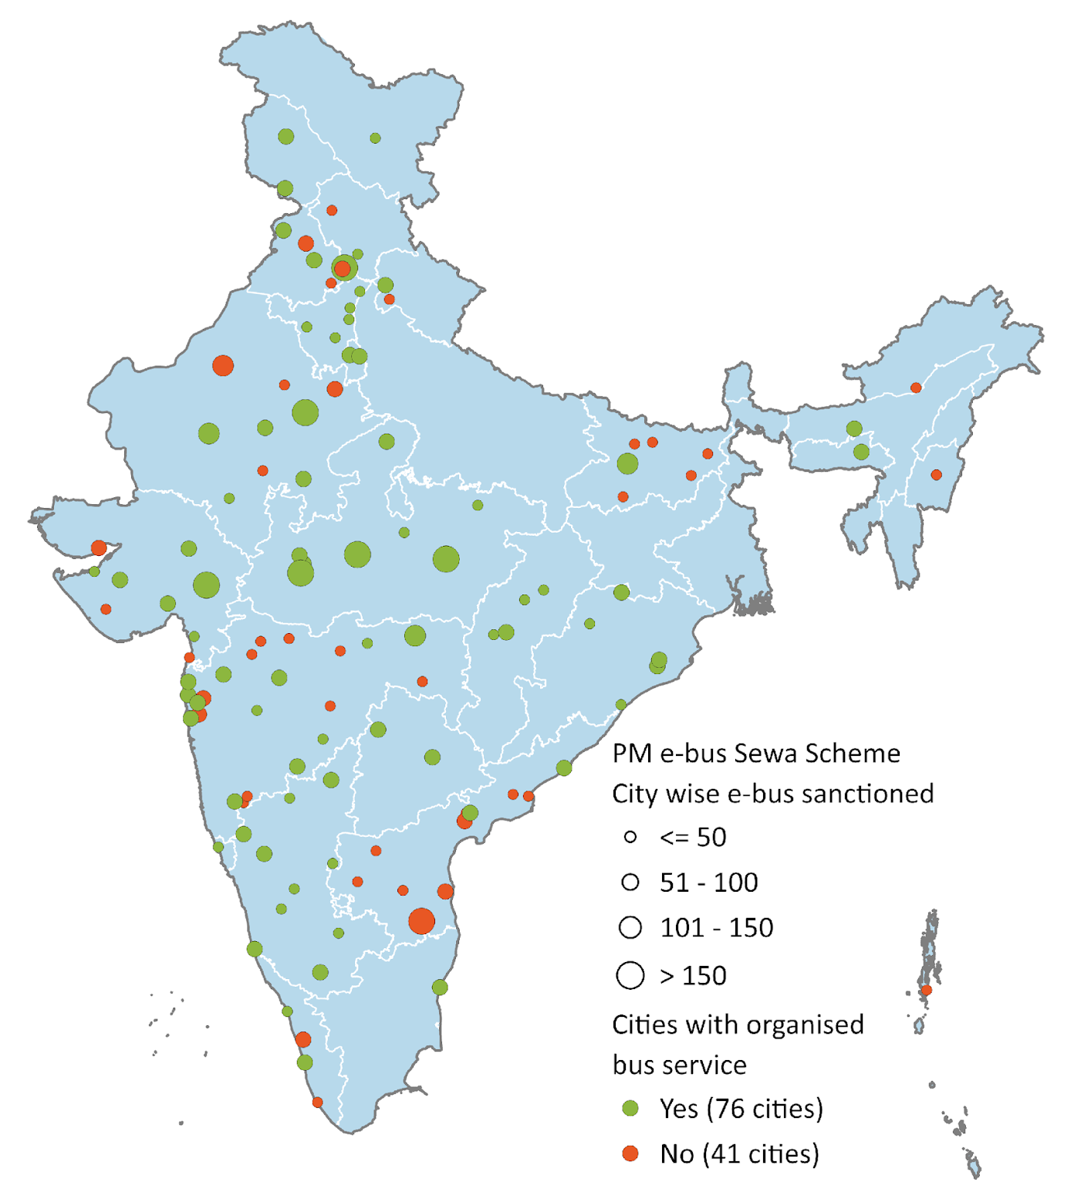

Our project can create a cumulative benefit assessment for 100+ PM e-Bus Sewa cities
As part of the Government of India’s PM e-Bus Sewa scheme, 10,000 electric buses will be deployed in 100+ Indian cities. The main criterion for this scheme is a city population between 3 and 40 lakh.
Figure 1: PM-eBus Sewa covers 117 cities across 26 states & UTs
These cities are growing
50% population share amongst India’s Class I cities 45% of India’s start-ups originated from non-metro cities, falling within this population range⁵ High capital investments in flexible workspaces, residential projects, data centres, etc.⁶
These cities also face challenges
81 out of the 131 NCAP cities of India; these cities consistently struggle with poor air quality throughout the year.⁷ Unchecked urban expansion and low-density development due to lack of regulated planning.⁸
India has 450+ cities with a population above 1 lakh – Class I cities¹
300+ cities with a population between 1 and 3 lakh²
PM e-Bus Sewa focus
140+ cities with a population between 3 and 40 lakh³
9 cities with a population above 40 lakh⁴
Source: Authors’ compilation
25|
Source: 1,2,3. Census 2011; 4. PIB 2025, 5. PIB 2024, 6. Colliers 2025, 7. MoEFCC; 8. Ramanna 2025
UT: Union territory
Notes:
Change the map

Slide 26
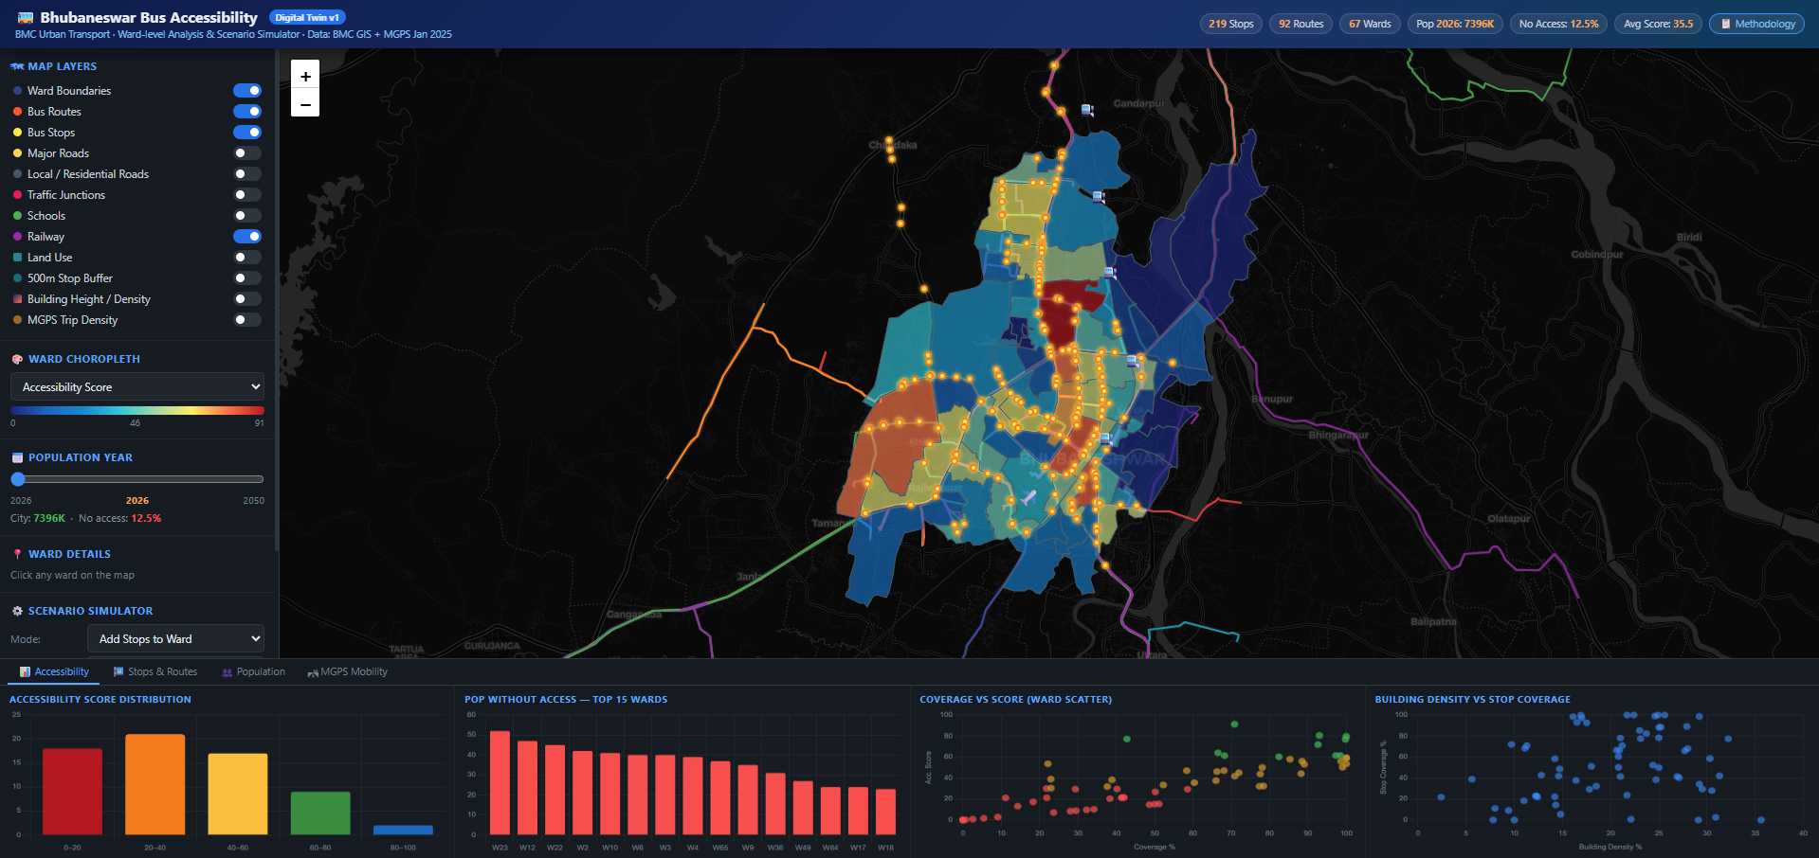
Updates on Bhubaneswar - link
26|
Source: CEEW analysis

Slide 27
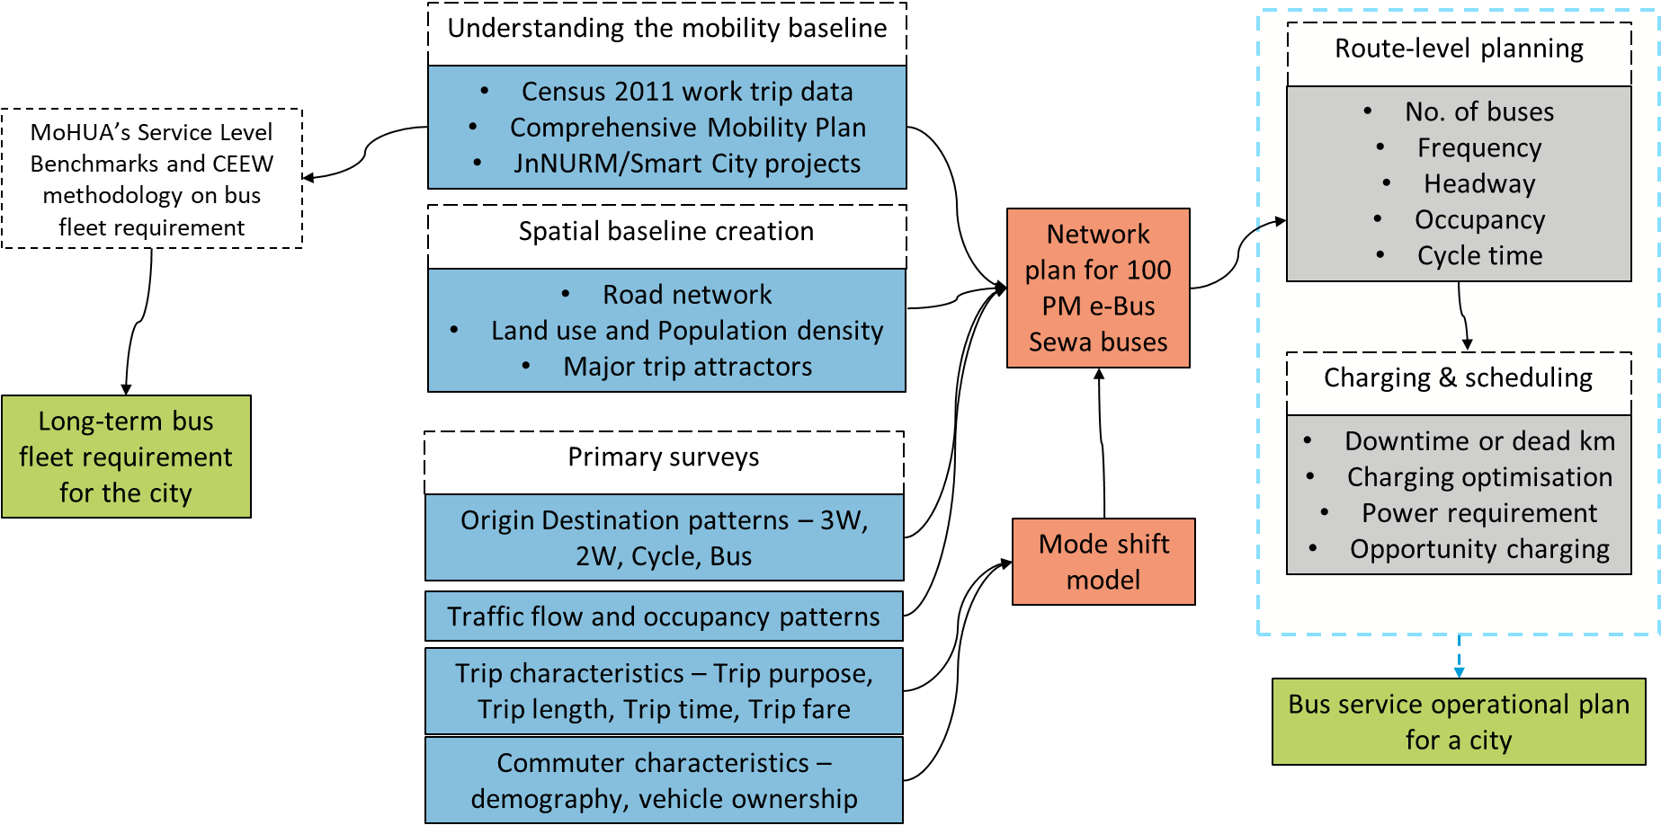
Scaling e-bus planning using ready-to-use tools (especially for newer cities)
27|
Source: CEEW compilation

Slide 28
Major outputs till now

Slide 29
Thank you

